Slide 1

Dance with MUING III

Slide 2

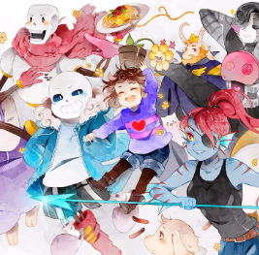
更多
谱面背景
点击开始游戏
Kiss me
10067 S
历史高分
Kiss me
难度等级标识
Hopes and Dreams
Hopes and Dreams

Slide 3




<
+
Kiss me
Volume
60%
MUING III (ver.1.0.0) , made by Error 404

Slide 4
<
Touch your number pad!
Export
1
2
Kiss me
0:51/3:10

Slide 5
<
233666
1
2
Kiss me
30%

Slide 6
<
Kiss me
10067 S
Played on 2019/6/28 21:58

Slide 7

<
Drag your song here

